Slide 1
PORTFOLIO · WORK SAMPLES
Tom Proctor
Content Strategy · Content Design · Technical Writing
Selected work from PayPal, PayPal Credit, Xoom, Symantec, Autodesk, and SpringCM
All examples are real and shared with permission for work-sample discussion. I was the primary content owner on every project shown.
Notes:
Original deck dated June 18, 2025. Companies: PayPal, PayPal Credit, Xoom, Symantec, Autodesk, Connectix and others.

Slide 2
CASE STUDY · PAYPAL CREDIT
PayPal Credit Website Redesign
When PayPal sold its Credit portfolio to Synchrony Bank, our team completed the in-flight redesign across two companies' design and legal teams — on a hard deadline.
Improved information architecture, rebuilt navigation, and simplified key workflows prior to handoff, including legally required changes.
Delivered on time with satisfied stakeholders at both companies. The redesigned site is still live today, largely unchanged.
“
You were the best writer at PayPal, hands down. Seriously.
$6B
2× $3K
On time
Beth Wells
Director of User Experience, PayPal
Portfolio sale to Synchrony
PayPal Spot Awards
Cross-company delivery
Notes:
In a 6 billion dollar deal, PayPal sold its PayPal Credit portfolio to Synchrony Bank. Our Credit team worked with Synchrony design and legal to complete the redesign already underway. We improved IA, redesigned navigation, improved key workflows prior to handoff under a tight deadline. Received 2 PayPal Spot Awards of $3K each from senior management.

Slide 3
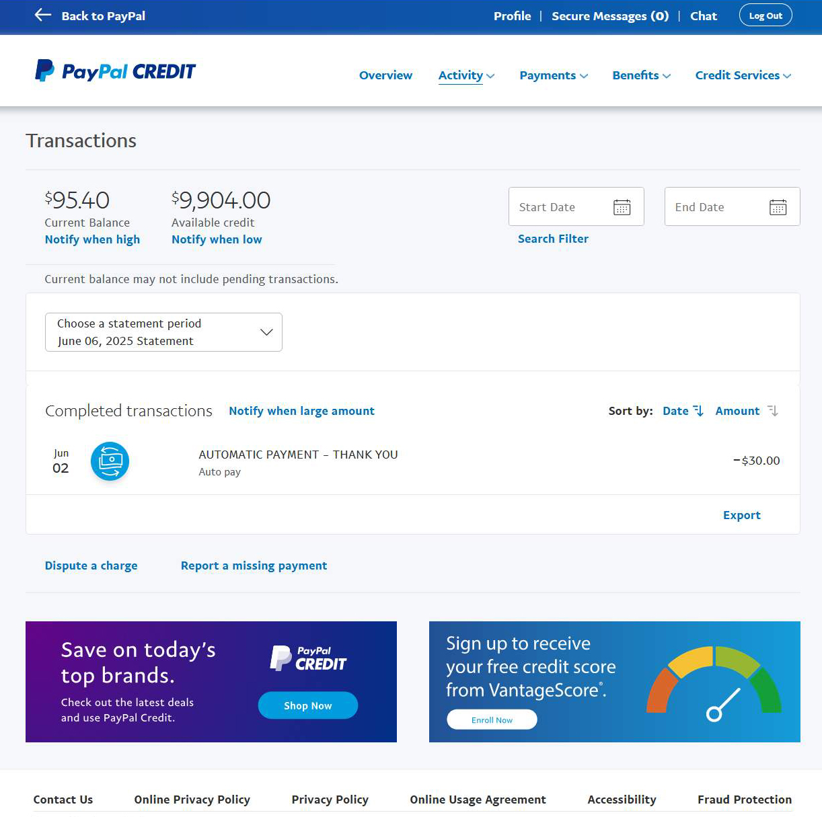
PAYPAL CREDIT · SCREEN 1 OF 3
Transactions
Created a simple at-a-glance transactions reporting page.
Reviewed and tested layouts, labels, and touchpoints; aligned navigation across PayPal and Synchrony Bank.
Uncrowded, balanced layout with room for banners and a notifications framework driven by user feedback.
Outcome Happier users, reduced call volume, and a page design that has held up for years.
Notes:
Provided uncrowded and balanced layout with room for banner elements. Added notifications framework with alert options based on user feedback. Allowed for whitespace elegance and banner placements without clutter.

Slide 4
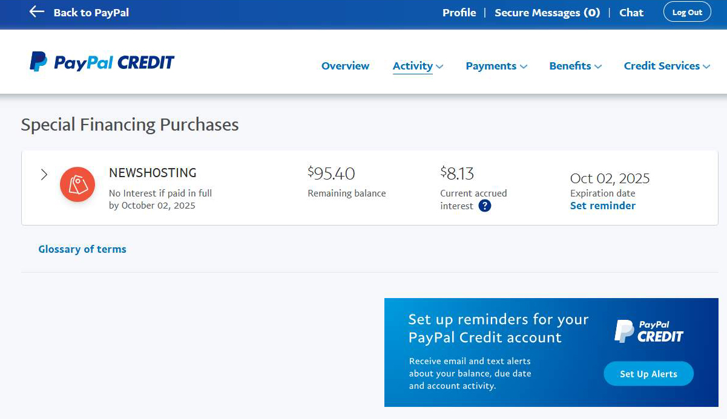
PAYPAL CREDIT · SCREEN 2 OF 3
Special Financing
Minimalist redesign of special purchase amounts, terms, expiration dates, and reminders.
Replaced the confusing “Deals and Offers” label — extensive customer testing landed on “Special Financing.”
Built around one insight: customers need a clear way to see when offers expire, so they avoid surprise interest and fees.
Outcome Customers told us this transparency set the brand apart from typical lenders — a page designed to build loyalty, and it did.
Notes:
A typical special-finance purchase: no interest or fees if fully paid within 6 months; miss it and the customer takes a big hit on interest. Customer feedback: 'looking out for them, not ripping them off like most banks and cards do.'

Slide 5
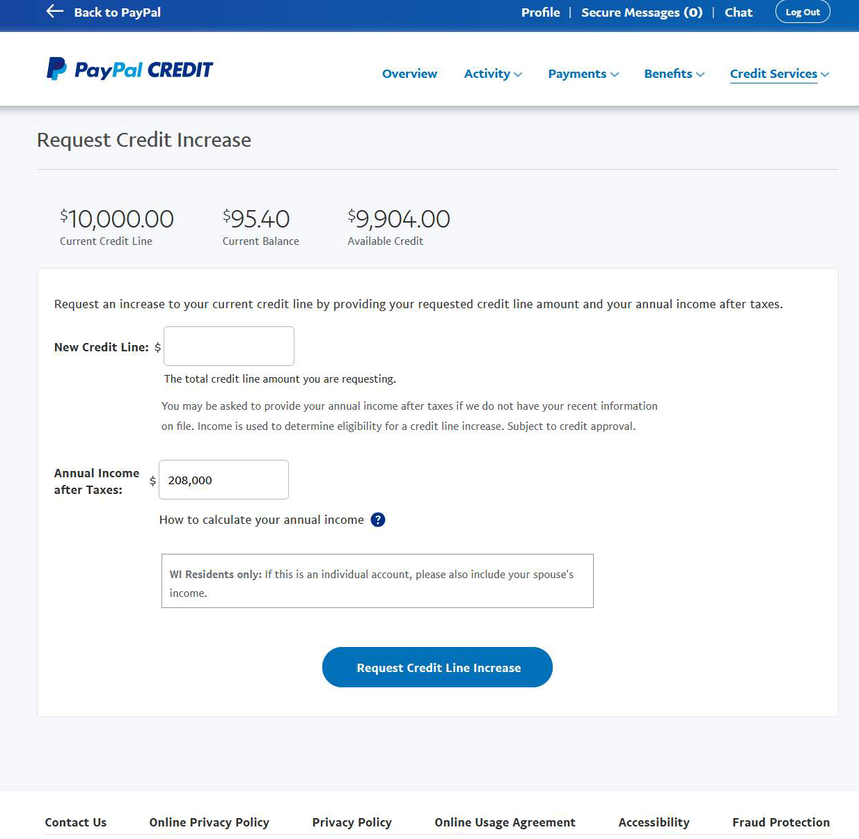
PAYPAL CREDIT · SCREEN 3 OF 3
Credit Increase
Standalone Request Credit Increase page showing account balances, in line with Synchrony standards.
Clear labels and contextual help for the two amount fields — a known point of confusion in the old UI.
Inserted the legally required disclaimer without breaking the look and feel of the page.
Unchanged since 2022
Tested well and shipped — still running as designed
Notes:
This page tested well and has been implemented without changes since 2022.

Slide 6
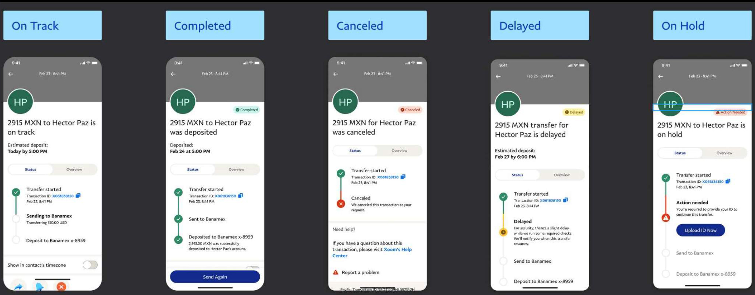
CASE STUDY · XOOM (A PAYPAL SERVICE)
Real-Time Transaction Tracking
Money tracking was missing at Xoom — a real competitive disadvantage against Western Union and Remitly.
We built a framework to handle every event in a money transfer's life inside the mobile UI.
Mapped hundreds of possible cases with engineering, pairing each with messaging that tells customers exactly where their money is — and what to do when action is needed.
Five top-level states — On Track, Completed, Canceled, Delayed, On Hold — each with its own visual language.
Notes:
The ability to track transaction progress in real-time was an important milestone for Xoom and its customers. This involved mapping hundreds of possible cases with engineers and providing relevant messaging to empower customers.

Slide 7
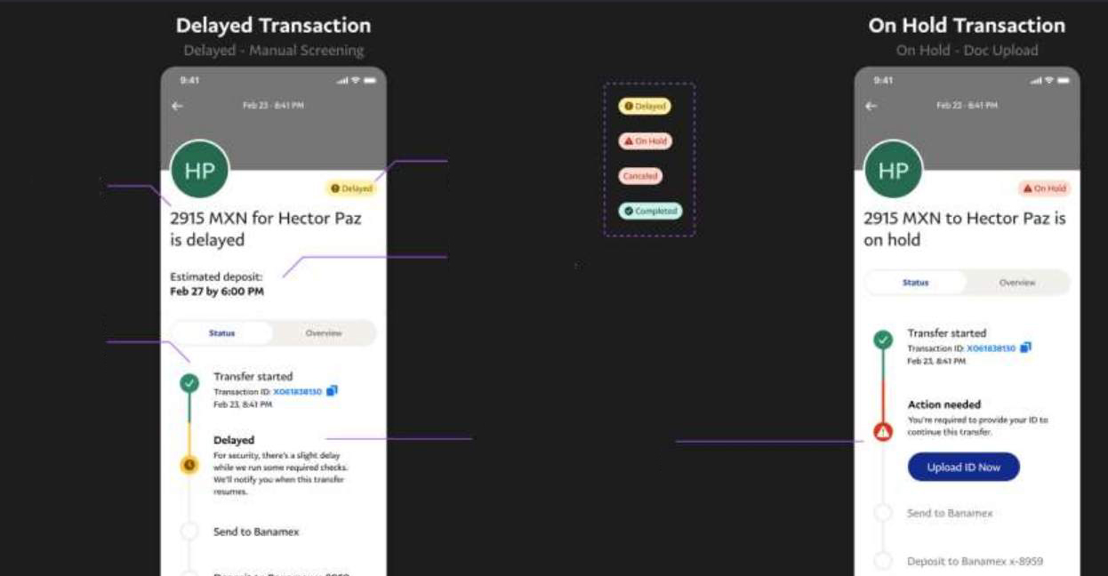
XOOM · TRANSACTION TRACKING
Anatomy of the Framework
At-a-glance status
Color-coded badges and time-to-money, visible instantly.
Milestone content
Visual cues, what went wrong, next steps, and a remediation link when action is needed.
Timeline milestones
Key steps shown in past, present, and future states.
Outcome Transfer-related call volume dropped significantly and customer feedback was strongly positive — a cross-team win for customers, support, and the business.
Notes:
Call volume related to money-transfer issues with banks and general delays was significantly reduced; customer feedback extremely positive. Helps compete with Western Union and Remitly.

Slide 8




CASE STUDY · PAYPAL
Regulatory Change Management
One of PayPal's most demanding content roles: keeping every product's content compliant as global regulations shift — without losing the user.
Owned content and legal review
Managed the review process for global PayPal product updates against evolving regulatory requirements.
Drove alignment and signoff
Partnered with legal to complete high-impact content changes under tight deadlines.
Advocated for the user
Sole advocate for accessibility, clarity, and brand voice — simplifying legal language across all PayPal products.
Ran the approval machine
Owned legal approval workflows: meetings, JIRA tracking, and consistent delivery under intense time pressure.
Notes:
Managed content and legal review for global PayPal product updates. Worked closely with legal partners to drive alignment, secure signoff, and complete high-impact changes under tight deadlines.

Slide 9
CASE STUDY · SYMANTEC TRUST SERVICES
Tackling the #1 Support Issue
40%
SSL certificates are essential for web security — but deeply technical, and average users struggled to install and manage them.
Customers tried anyway to save money, then got stuck.
With the Verisign acquisition, Symantec inherited an enormous customer base — and certificate installation became its single biggest support burden.
of support calls were about certificate delivery and installation
Notes:
SSL certificate and intermediate certificate installation was the #1 support issue for Symantec, which acquired the famous Verisign brand. 40% of support calls related to certificate delivery and installation.

Slide 10
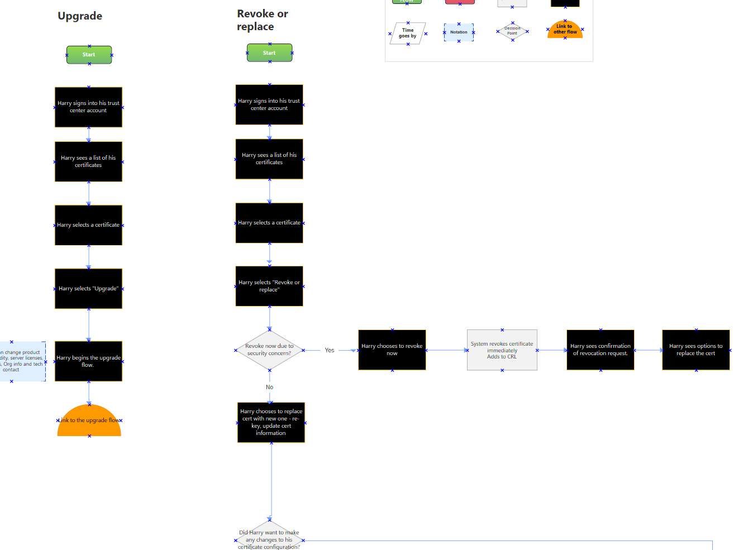
SSL CERTIFICATE INSTALLS · DISCOVERY
Two Users, One Broken Journey
Non-admin users
Know the basic concepts but not servers or jargon. Need help along the way, step by step.
Admin / technical users
Fluent in SSL and server administration. Want the bare steps — no hand-holding.
Issue 1 — Delivery: certificates arrived as email attachments, an outdated method that failed many users.
Issue 2 — CSR generation: creating a CSR on their own server was a technical wall that ended in support calls.
Notes:
Through user research we agreed on two general personas. UX created detailed task-flow steps; UX and content storyboarded the flows with a fresh look at key decision points on a task-specific basis.

Slide 11
SSL CERTIFICATE INSTALLS · REDESIGN
Six Moves That Fixed the Journey
1 · Reorder the intake
2 · Task-focused content
3 · Education at pain points
Collect the right information first, routing each user down one of three paths suited to their needs.
Refocused every message on user tasks; rigorously tested and peer-reviewed new content, with contextual help placed where eyes land.
Tooltips, sample CSRs, code samples, videos, and help links exactly where users get stuck — invisible to experts who don't need them.
4 · Server selection wizard
5 · Special-case UI
6 · Support in the room
Pick server type and version up front, enabling smart defaults and installation guidance specific to the user's setup.
Added flows for variable server environments that previously always ended in a support call.
Support engineers joined design iteration directly, sharpening the designs against real ticket knowledge.
Notes:
Solutions 1-6 consolidated from the original deck's six solution slides.

Slide 12
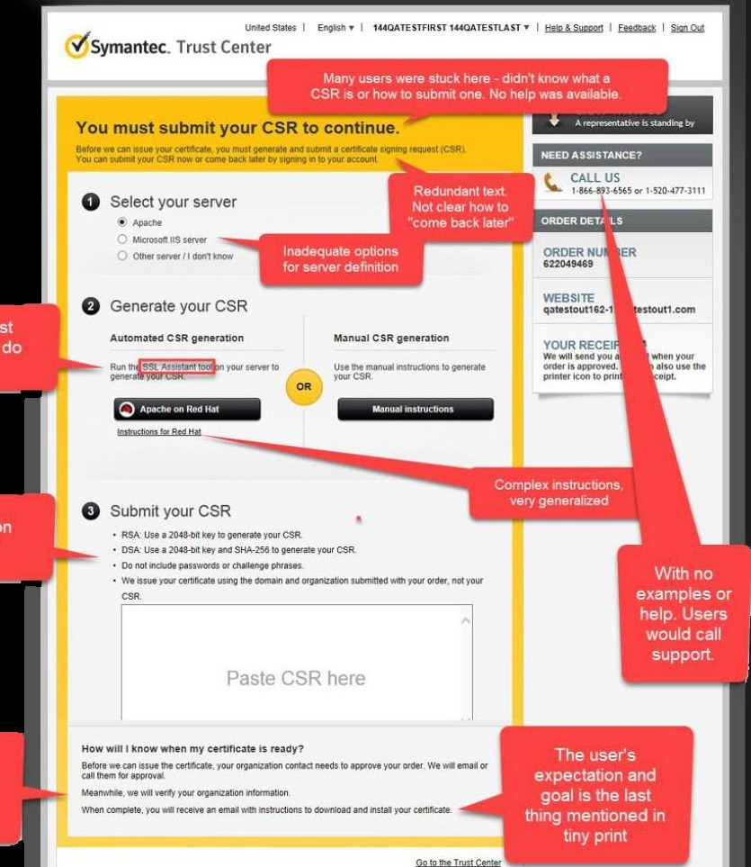
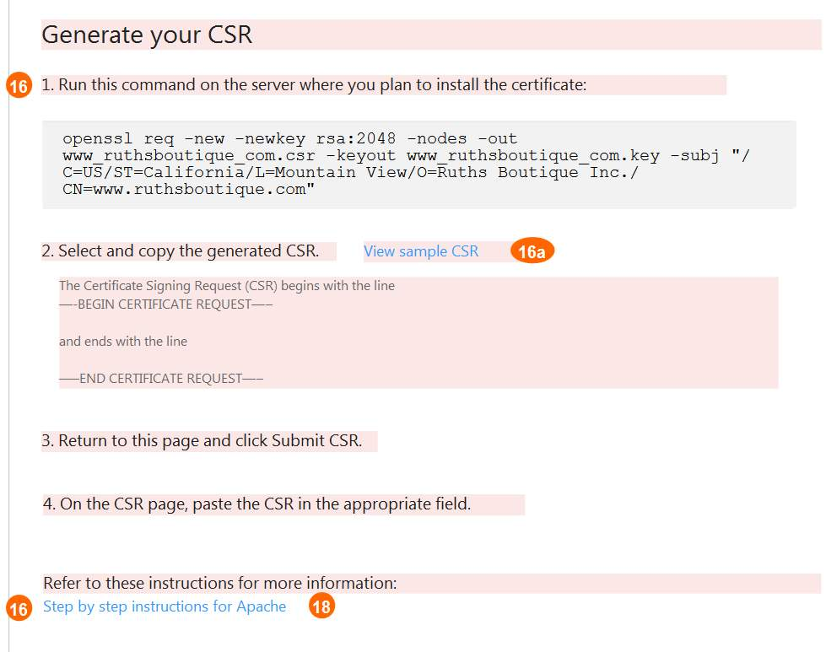
SSL CERTIFICATE INSTALLS · THE WORK
Before and After: Generating a CSR
BEFORE — annotated audit
AFTER — clear steps, help where users get stuck
I tagged every known issue on the original page — this annotated audit became the shared map for interaction designers and stakeholders.
Notes:
Visual analysis: evaluated the existing page and created tags indicating known issues. The diagram proved useful in discussions with interaction designers and stakeholders.

Slide 13
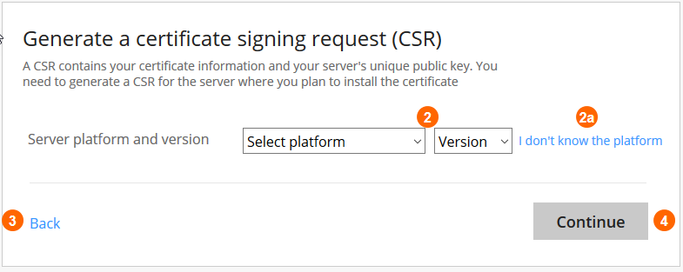
SSL CERTIFICATE INSTALLS · RESULTS
A Measurable Win for the Verisign Brand
Immediate positive feedback from the support team and customers on launch.
Support calls dropped as the upgrades removed the top drivers of confusion; customers used to the old process were notably happier.
Real-world evidence and the test of time validated the design assumptions.
Core product improvements behind what was then the most recognized brand on the internet — the Verisign check mark.
The server-selection wizard — smart defaults from two dropdowns.
Notes:
Successful implementation yielded immediate positive feedback. The process illustrates teamwork, strategy, and planning in corporate content and app design.

Slide 14
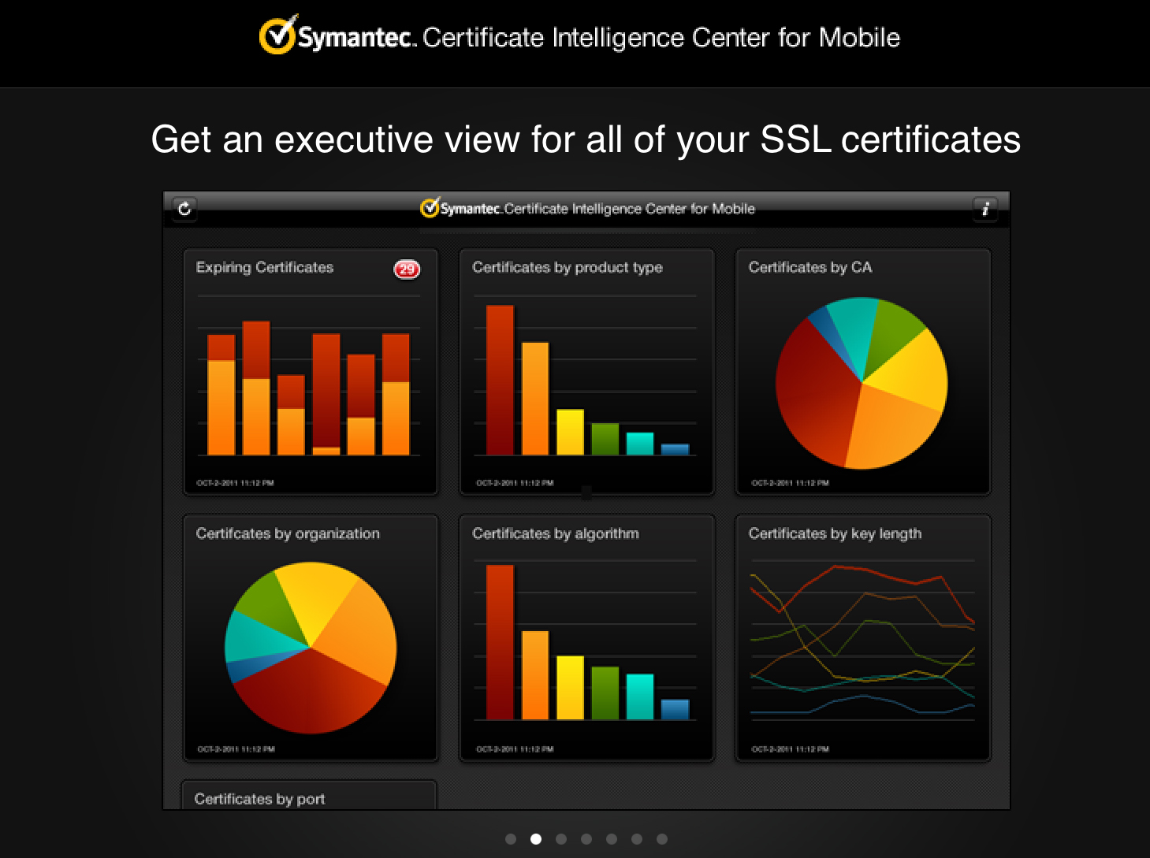
SYMANTEC · ENTERPRISE SOFTWARE
Certificate Intelligence Center
Principal Information Developer on a $50M enterprise product: discover every SSL certificate on a large network — a bank's, say — and report status and expiration at scale.
Deeply technical product; documentation had to carry much of the complexity.
Wrote the CIC Installation Guide, the Technical Manual, the Quick Reference Guide, and release notes for the earliest versions.
Notes:
Principal Information Developer (fancy name for Content) for this $50M project to build software for enterprises managing large SSL cert installations.

Slide 15
ESRI · TECHNICAL WRITER · 2009–2010
ArcGIS Help & the GIS Wiki
Wrote and maintained help content for ArcGIS, the industry-standard GIS platform used by governments, utilities, and researchers worldwide.
Contributed to Esri's GIS Wiki — community-facing, structured reference content for geospatial concepts and workflows.
Deeply technical domain: geoprocessing, spatial analysis, and cartographic tooling, translated for a mixed audience of analysts and developers.
ArcGIS
The world's leading GIS platform
Early structured, wiki-based documentation — the same discipline behind my archive and content-systems work today.
Notes:
Esri, Redlands CA — GIS software and mapping. Worked on the GIS Wiki (wiki.gis.com) and ArcGIS help files. Roughly one year, after Autodesk (~2009-2010; Tom to confirm exact dates).

Slide 16
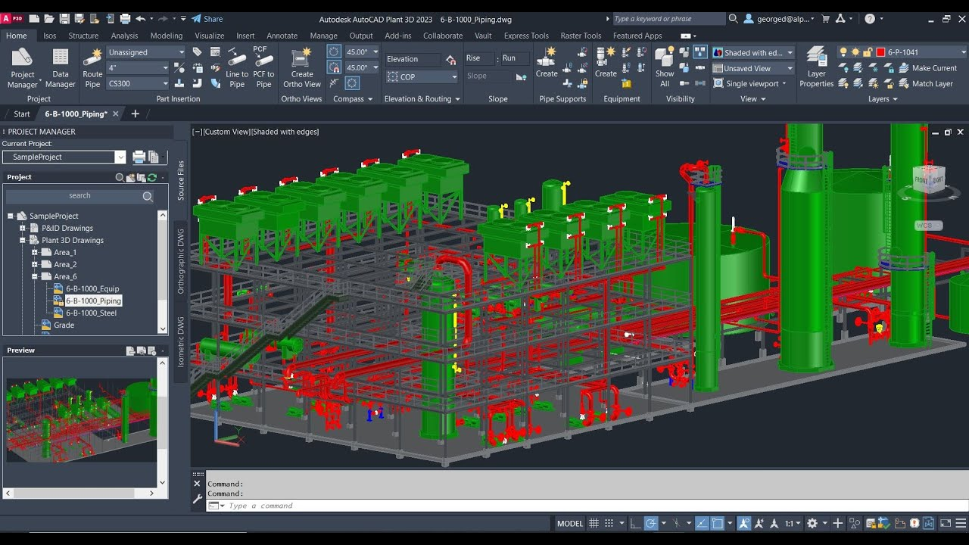
AUTODESK · SENIOR TECHNICAL WRITER
AutoCAD Plant 3D & AutoCAD P&ID
3D CAD tools engineers use to design power plants, refineries, and other large piping infrastructure, built on libraries of real-world parts.
Wrote the labels, tooltips, and help for one of the densest specialized interfaces in the product line, plus the Specs & Catalogs Editor manual.
Content vetted with piping engineers around the world — including the 2 a.m. calls — and with the local product owner and core team.
19 languages
Every string localized — written for reuse to cut translation cost
Notes:
Remember the Windows pipes screensaver? That's close to the output. Trained to write consistently with reusable phrases to conserve translation costs across 19 languages. Manuals of step-by-step procedures that make sense only to engineers — accurate and well vetted by SMEs.

Slide 17

CONNECTIX · TECHNICAL WRITER · 2003
Documenting the First Practical Desktop Virtual Machine
Wrote the user manuals for Connectix Virtual PC, letting a single Mac or PC run another operating system as a virtual machine — years before “cloud” or “VM instance” were everyday words.
The technology was disruptive enough to threaten Microsoft's own platform strategy.
Microsoft acquired Connectix's virtualization line in February 2003, absorbing Virtual PC and Virtual Server directly into its own products.
Feb 2003
Acquired by Microsoft
My earliest role shown here — Connectix predates the PayPal, Symantec, and Autodesk work in this deck.
Notes:
Connectix built Virtual PC, one of the first practical desktop virtualization products — the technology behind today's cloud instances and containers. Microsoft acquired Connectix's virtualization business in February 2003. Confirm exact date if asked; from memory, verified by Tom.

Slide 18
SPRINGCM · SENIOR TECHNICAL WRITER
Documenting SaaS Before It Was Called SaaS
SpringCM delivered document management as a service long before Dropbox was a household name. Working directly with the CEO — remotely, in an era when that was rare — I developed the company's key documentation, including the SpringCM User Guide.
Thank you
Tom Proctor tom@proc.us · proc.us · 2200studios.us
Notes:
SpringCM: innovative document management firm providing software as a service before Dropbox. Worked directly with the CEO remotely to develop key documentation such as the SpringCM User Guide.

